Slide 1
Management Committee Meeting (MC3)
CA18203 - Optimising Design for Inspection, Virtual Meeting
11th March 2021
10am - Noon

Slide 2
1. Welcome to Participants
Name: Rhys Pullin
Organization: Cardiff University, Wales
Email: pullinr@cardiff.ac.uk
Management Committee Meeting (MC3)

Slide 3
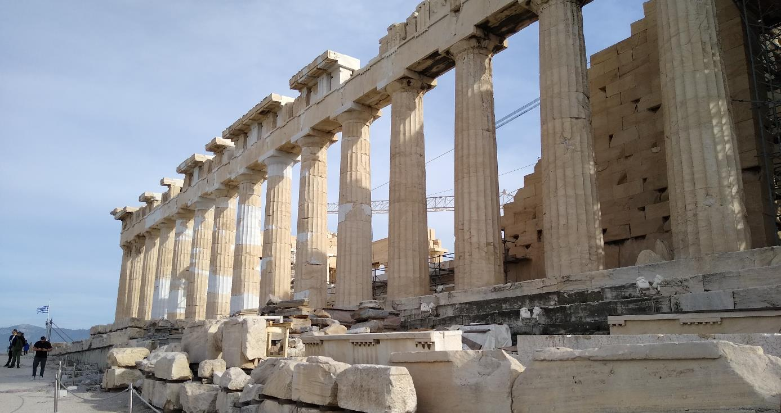
1. Welcome to New Participants

Slide 4
2. Quorum?
Management Committee Meeting (MC3)

Slide 5
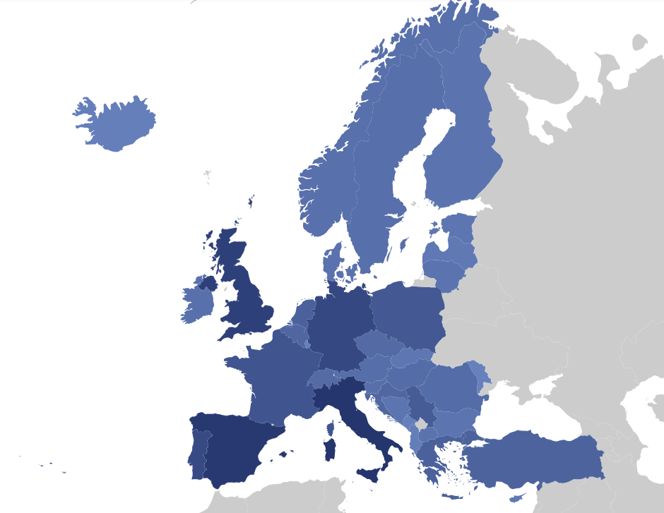
2. Quorum?
Verification of the presence of two-thirds of the Participating COST Countries
  28 Participant Countries
  Are we 18 countries?
Management Committee Meeting (MC3)

Slide 6
2. Quorum?
Cyprus, Czech Republic, Germany, Spain, Estonia, France, Greece, Croatia, Italy, Israel, Iceland, Ireland, Lithuania, North Macedonia, Netherlands, Portugal, Poland, Romania, Sweden, Slovenia, Turkey, Belgium, Bosnia and Herzegovina, Bulgaria, Serbia, Finland, Latvia, United Kingdom.
Management Committee Meeting (MC3)

Slide 7
3. Adoption of Agenda
Management Committee Meeting (MC3)

Slide 8
3. Agenda (1/2)
Welcome to participants (RP)
Verification of the presence of two-thirds of the Participating COST Countries or, if applicable, a quorum (All)
Adoption of Agenda (RP)
Actions from last meeting (RP)
Update from the Action Chair (RP)
Update from Grant Holder (RU)
Update from Communications Officer (PD)
Management Committee Meeting (MC3)

Slide 9
3. Agenda (2/2)
Update from COST Association (RP)
Update from Workgroup Leads
Scientific planning a) Scientific strategy b) Long term planning (including anticipated locations and dates of future activities) c) Dissemination planning (Publications and outreach activities)
AOB
Location and date of next meeting
Summary of MC decisions
MC Closing
Management Committee Meeting (MC3)

Slide 10
4. Actions from Last Meeting
Management Committee Meeting (MC3)

Slide 11
4. Actions from Last Meeting (RP)
Launch E-Vote based on presented change (detailed below)
  for the infographics and illustrations (7500€ from BCMTEC)
  for the editing of the book (€ 5.728,22 for Markus)
  for publishing review paper on energy harvesting (APC + copyright of figures 2-3k€ - Sasa)
Investigate with KM STSM plans
Sign up to LinkedIN and You Tube channel
Provide website content to PD
Investigate possibility of ECR webinar
Launch doodle poll for online MC meeting
Management Committee Meeting (MC3)

Slide 12
5. Update from the Action Chair
Management Committee Meeting (MC3)

Slide 13
Action Status
Start Date: 2nd October 2019
End Date: 1st October 2023
CSO Approval Date: 4th June 2019
Entry into Force: 4th July 2019
MC Meeting 1: 2nd October 2019
MC Meeting 2: 25th February 2020
Science Officer: Dr Karina Marcus
Administrative Officer: Olga Gorczyca
Management Committee Meeting (MC3)

Slide 14
Network Update (10/2020)
Inclusive Target Countries
 | Participating Countries [%] | MC Members [%] | Leadership Roles [%] | Relative representation of ITC’s in Leadership Roles [%]
ODIN | 54 | 50 | 40 | 80
All Actions | 52 | 50 | 29 | 58
"Leadership roles %" displays the proportion of the Action leadership roles (Action Chair, Action Vice Chair, Grant Holder Scientific Representative, WG Leaders, STSM Coordinator and Science Communication Manager) that are held by representatives targeted by each dimension of the Excellence and Inclusiveness Policy, and "Relative representation in Leadership roles" is calculated by dividing the proportion of Leadership roles by the proportion of MC Members"
Management Committee Meeting (MC3)

Slide 15
Network Update (10/2020)
Early Career Investigators
 | MC Members [%] | Leadership Roles [%] | Relative representation of ITC’s in Leadership Roles [%]
ODIN | 20 | 30 | 150
All Actions | 18 | 16 | 89
"Leadership roles %" displays the proportion of the Action leadership roles (Action Chair, Action Vice Chair, Grant Holder Scientific Representative, WG Leaders, STSM Coordinator and Science Communication Manager) that are held by representatives targeted by each dimension of the Excellence and Inclusiveness Policy, and "Relative representation in Leadership roles" is calculated by dividing the proportion of Leadership roles by the proportion of MC Members"
Management Committee Meeting (MC3)

Slide 16
Network Update (10/2020)
Gender Balance
 | MC Members [%] | Leadership Roles [%] | Relative representation of ITC’s in Leadership Roles [%]
ODIN | 20 | 30 | 150
All Actions | 43 | 46 | 107
"Leadership roles %" displays the proportion of the Action leadership roles (Action Chair, Action Vice Chair, Grant Holder Scientific Representative, WG Leaders, STSM Coordinator and Science Communication Manager) that are held by representatives targeted by each dimension of the Excellence and Inclusiveness Policy, and "Relative representation in Leadership roles" is calculated by dividing the proportion of Leadership roles by the proportion of MC Members"
Management Committee Meeting (MC3)

Slide 17
Action Plan
Ensure that all organised conference sessions include over 50% ITC participants, ECI's and females. Where possible ECI's will be given opportunities to chair sessions and hold outward facing prominent positions.
Ensure that when opportunities to represent the ACTION at International Conferences an ITC/ECI/Female member is invited
Ensure that in the case of a Core Group position becomes available an ITC/ECI/Female member is invited to take the position
Prioritise applications to STSMs from ITC countries and ECI/Female representatives
Promote STEM learning through developed teaching resources to encourage Female and ITC involvement
Aim to use gender neutral language in all promotions of activities such as training schools and STSM's
Management Committee Meeting (MC3)

Slide 18
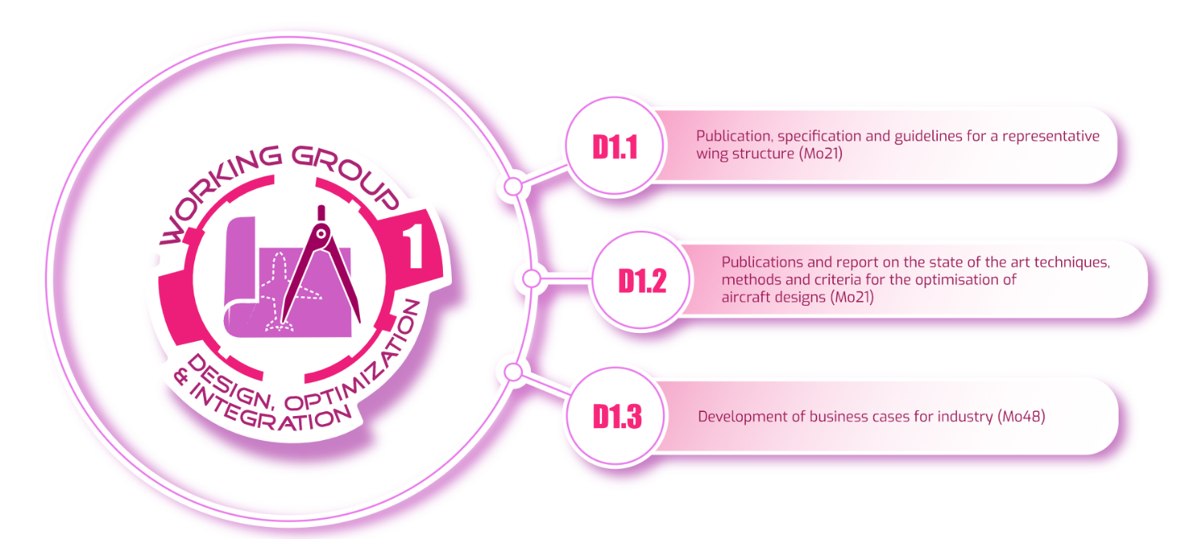
Deliverables
Management Committee Meeting (MC3)

Slide 19
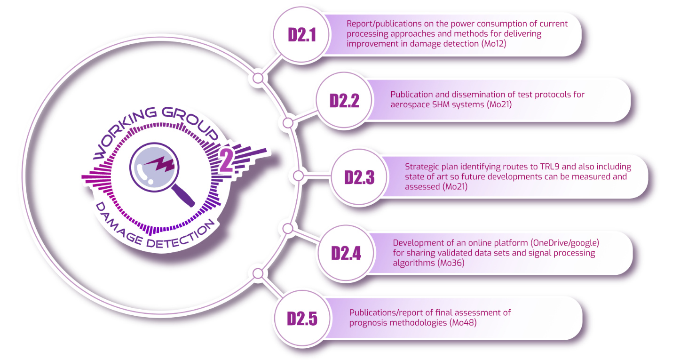
Deliverables
Management Committee Meeting (MC3)

Slide 20
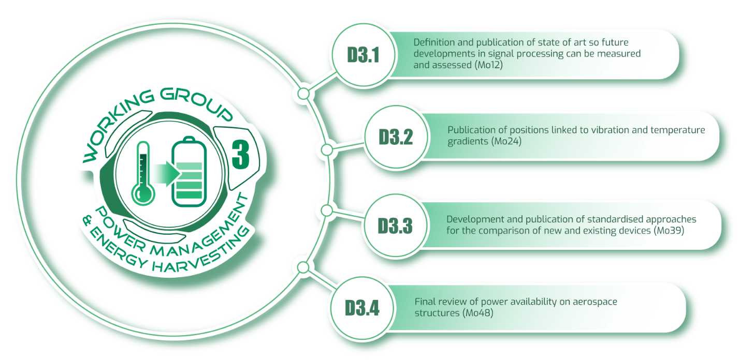
Deliverables
Management Committee Meeting (MC3)

Slide 21
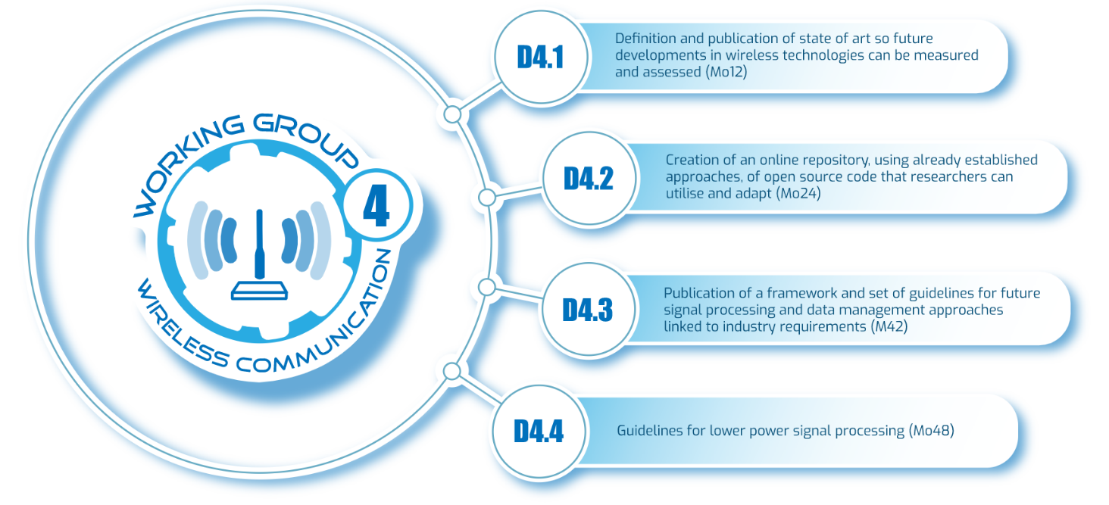
Deliverables
Management Committee Meeting (MC3)

Slide 22
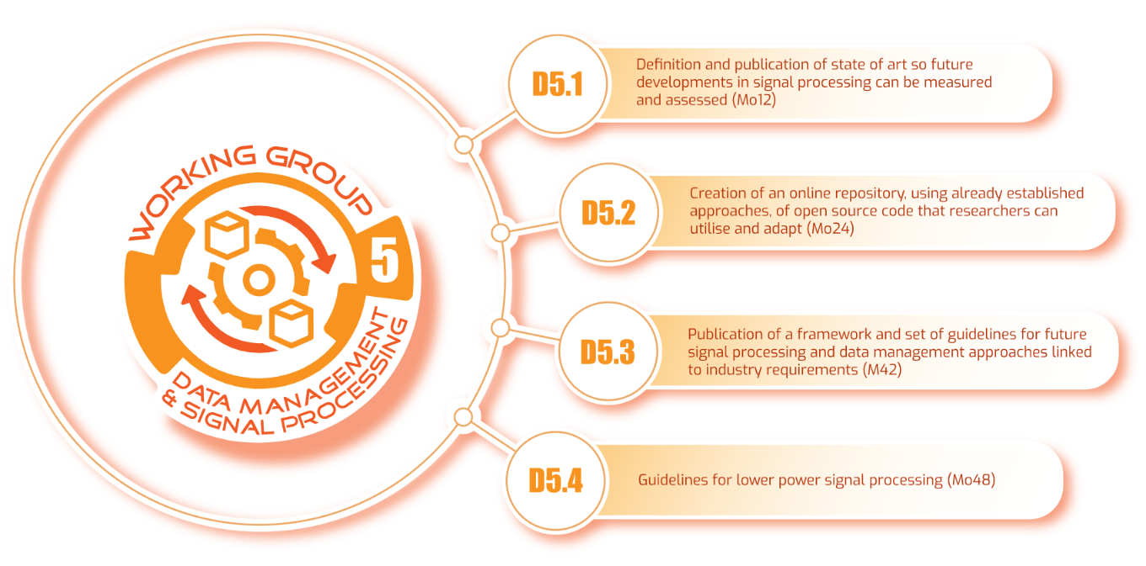
Deliverables
Management Committee Meeting (MC3)

Slide 23
ODIN Activities MC1 to MC2
Special Session at EASN 2020
  Plus associated papers
  Planning 2021 EASN Session
British Council Grant Application (UK/Turkey)
New research collaboration (UK/Sweden)
New publications from all Work Groups
New website (needs content)
Developed outreach and teaching materials
Development of acoustic emission data set/wing model
Management Committee Meeting (MC3)

Slide 24
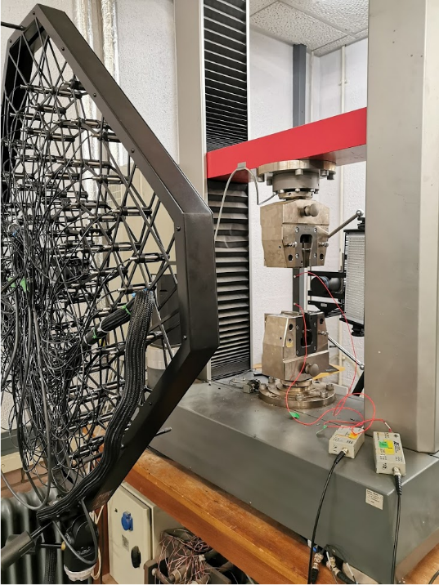
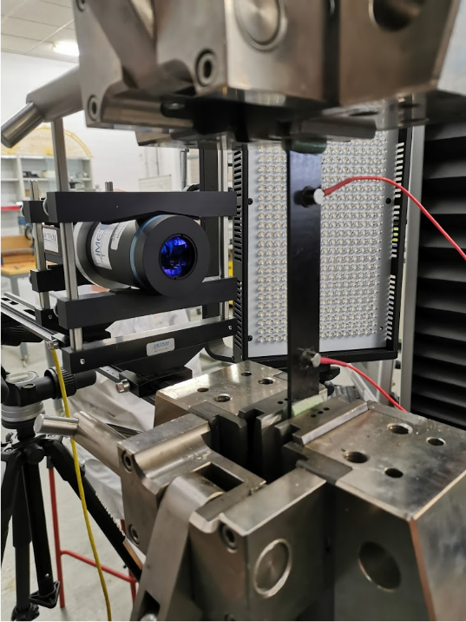
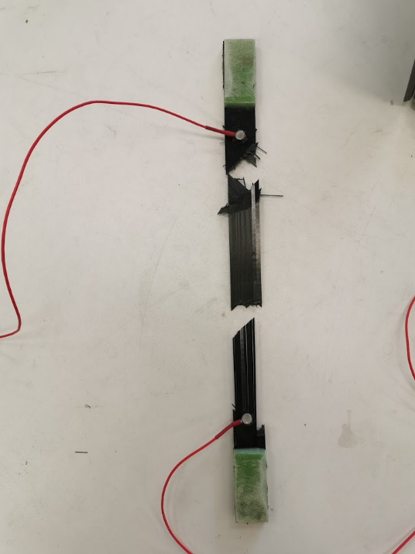
Data Set Development
Management Committee Meeting (MC3)

Slide 25
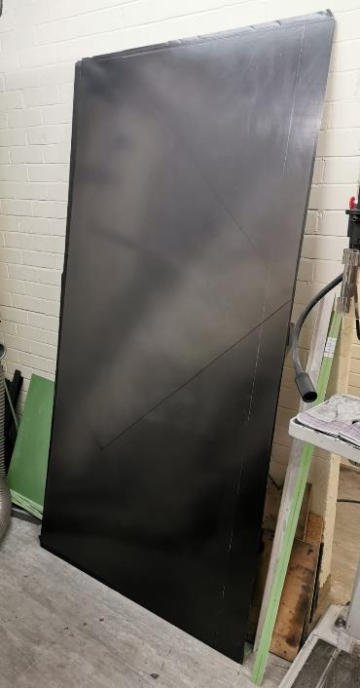
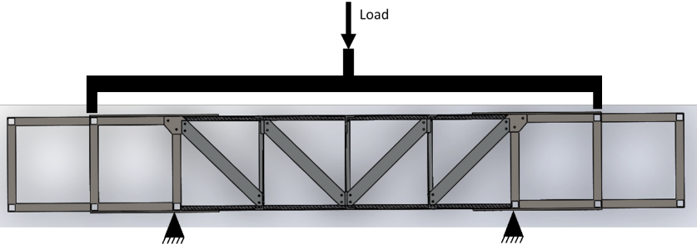
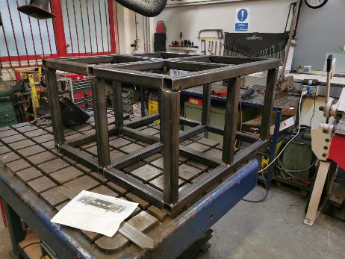
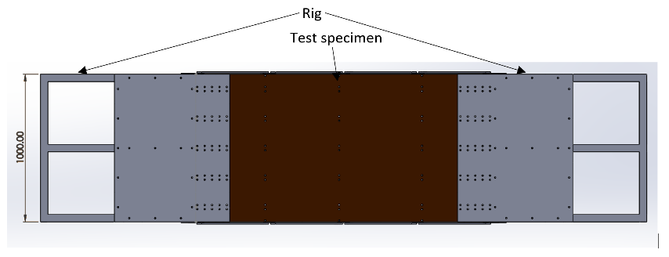
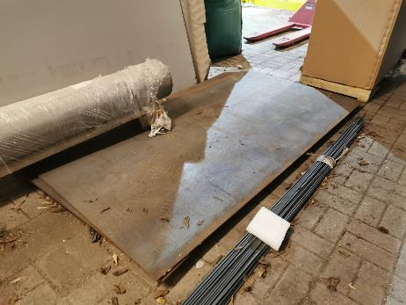
Technology Demonstrator
Management Committee Meeting (MC3)

Slide 26
5. Update from Grant Holder (RU)
Name: Rúnar Rúnar Unnþórsson
Organization: University of Iceland, Iceland
Email: runson@hi.is
Management Committee Meeting (MC3)

Slide 27
Budget status

Slide 28
Budget Status
Please take into account that this Grant period’s budget will be available for expenditure until October 31st only.
Grant Period 3 will start November 1st 2021 (duration and budget unknown).

Slide 29
7. Update from Communication Officer (PD)
Name: Petar I. DIMITROV
Organization: Air Traffic Researcher, North Macedonia
Email: dipetar@outlook.com
Management Committee Meeting (MC3)

Slide 30
Communicating Science in Times of COVID-19
Updates, www.odin-cost.com
  Additional information (Core Group, Events, Activities)
  Change of files in the Repository part (GDPR)
  Cost Press Review NOV 2020 (Energy Harvesting Technologies for Structural Health Monitoring of Airplane Components—A Review”)
  COST Awareness Days March 11th from 10.00 to 12.00
  Working on website based on KM feedback
Management Committee Meeting (MC3)

Slide 31
#OdinCost
We need more content and subscribers!
Youtube WE NEED - Videos
LinkedIn
Management Committee Meeting (MC3)

Slide 32
8. Update from COST Association (KM)
Management Committee Meeting (MC3)

Slide 33
Please see PDF below
Management Committee Meeting (MC3)

Slide 34
9. Update from Working Groups
Name: Chiara Bisagni
Organization: Delft University of Technology, Netherlands
Email: c.bisagni@tudelft.nl
Management Committee Meeting (MC3)

Slide 35
Working Groups One
Name: Chiara Bisagni
Organization: Delft University of Technology, Netherlands
Email: c.bisagni@tudelft.nl
Management Committee Meeting (MC3)

Slide 36
Outline
WG1 Tasks and Gantt Chart
WG1 Telecons
T1.2 Representative Wing Structure Element
Numerical Models of the Wing Element
Next Steps

Slide 37
WG1 Design, Optimisation and Integration
This group will encompass industrial aerospace design
engineers and experts, mathematicians, computer scientists and optimisers with the objective to analyse the requirements for integrating SHM systems at the inception of an aerospace design.
A significant challenge for this group is to ensure that specific aerospace requirements are communicated effectively and efficiently to the SHM system designers.

Slide 38
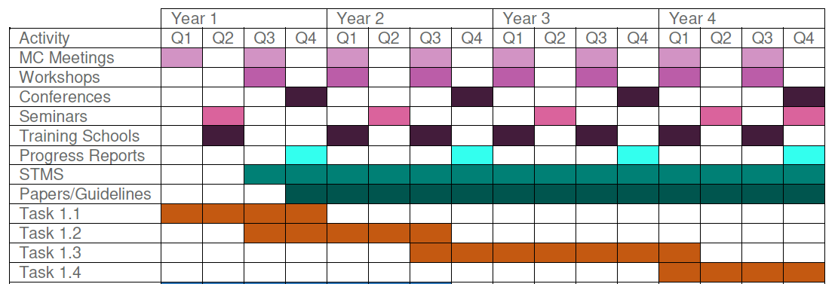
WG1 Tasks and Gantt Chart
T1.1: Increase industry participation through promotion and dissemination at trade shows, utilising existing participant contacts and the establishment of a social network ODIN group.
T1.2: Establish design criteria, based on industry requirements for a representative wing structure element. This will include geometry, loading, temperature etc. These criteria will be disseminated widely to increase network/WG1 participation. The data can then be used as the starting point for firstly optimisation due to loading and subsequently for an SHM system.
T1.3: Development of optimisation strategies and guidelines for systems and structures and design of demonstrator wing section.
T1.4: Dissemination of work group findings including industry guidelines through conference, trade shows, workshops and industrial seminars.
March 2021

Slide 39
WG1 Telecons
April 2, 2020
July 6, 2020
October 12, 2020
  Between 20 and 25 participants in each telecon
November 26, 2021
March 8, 2021
  Partners working on the design, optimization and testing of the representative wing structure element

Slide 40
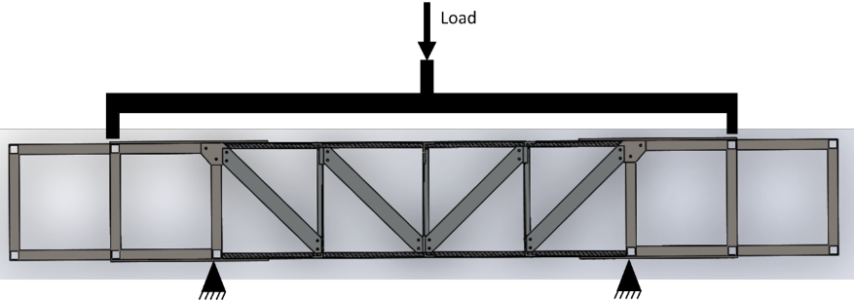

T1.2 Representative Wing Structure Element
A representative wing structure element has been identified
The wing element is ready to be manufactured, and then will tested, at Cardiff University
A few partners are working on numerical models
The wing element will be analysed, then optimised, firstly optimisation due to loading and subsequently for an SHM system

Slide 41
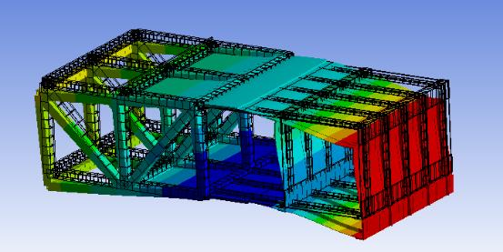
Numerical Models of the Wing Element
Elastic beam model
(INSA Rouen, France)
First bending mode - Ansys
(University of Belgrade, Serbia)
Static deformed shape - FE Abaqus
(Delft University of Technology, Netherlands)

Slide 42
Next Steps
Test of the wing element foreseen in May-June 2021
First joint paper hopefully before summer 2021
Then optimisation for an SHM system, close interaction with WG2

Slide 45
5. Working Groups Two
Name: Elena Jasiūnienė
Organization: Kaunas University of Technology, Lithuania
Email: elena.jasiuniene@ktu.lt
Management Committee Meeting (MC3)

Slide 46
WG2 - Deliverables
D2.1: Report/publications on the power consumption of current processing approaches and methods for delivering improvement in damage detection (Mo12);
D2.2: Publication and dissemination of test protocols for aerospace SHM systems (Mo21);
D2.3: Strategic plan identifying routes to TRL9 and also including state of art so future developments can be measured and assessed (Mo21);
D2.4: Development of an online platform(OneDrive/google) for sharing validated data sets and signal processing algorithms (Mo36);
D2.5: Publications/report of final assessment of prognosis methodologies (Mo48)

Slide 47

Publishing in Process
Introduction
Monitoring tasks in aerospace
Defect types
Aerospace requirements
Ultrasonics
Vibration based monitoring
Acoustic emission
Strain monitoring
Data reduction
Conclusions

Slide 48
WG2 - Deliverables
D2.1: Report/publications on the power consumption of current processing approaches and methods for delivering improvement in damage detection (Mo12);
D2.2: Publication and dissemination of test protocols for aerospace SHM systems (Mo21);
D2.3: Strategic plan identifying routes to TRL9 and also including state of art so future developments can be measured and assessed (Mo21);
D2.4: Development of an online platform(OneDrive/google) for sharing validated data sets and signal processing algorithms (Mo36);
D2.5: Publications/report of final assessment of prognosis methodologies (Mo48)

Slide 49
Conferences this year, which will take place
6th ICEAF International Conference of Engineering Against Failure 23-25 June in Spetses, Greece in hybrid format https://iceaf.eu/
Special session " Non-Destructive Testing and Structural Health Monitoring for prevention of failure"
11th EASN Conference "Innovation in Aviation & Space to the Satisfaction of the European Citizens" , 1 - 4 September 2021, in hybrid format (Salerno, Italy and virtual) https://easnconference.eu/
(dedicated session to ODIN will be organized)

Slide 50
5. Working Groups Three
Name: Sasa Zelenika
Organization: University of Rijeka, Crotia
Email: sasa.zelenika@riteh.hr
Management Committee Meeting (MC3)

Slide 51
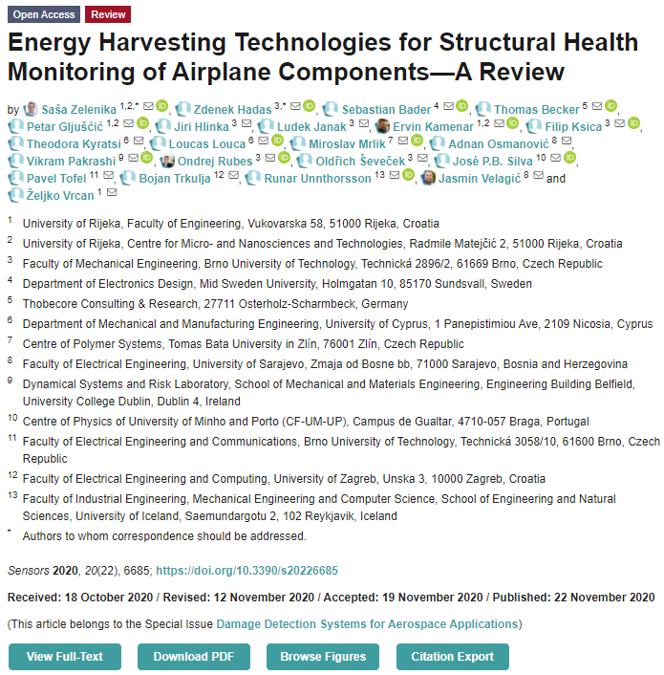
Publication
Sensors 2020, 20(22), 6685 (IF 3.275) – SI on Damage Detection Systems for Aerospace Applications
https://doi.org/10.3390/s20226685
57 page peer-reviewed review article
Ca. 1’500 views
Covers all pertinent EH technologies & power management electronics with respective boundary conditions for application in aircraft (placement, frequency/temp. ranges and similar) → comprises most parameters of foreseen deliverables and provides important dissemination result

Slide 52
WG3 Power management and energy harvesting
D3.1 Publication of state of art so future developments in energy harvesting/power management can be measured and assessed (M12)
D3.2 Publication of positions linked to vibration and temperature gradients (M24)
D3.3 Development and publication of standardized approaches for the comparison of new and existing devices (M39)
D3.4 Final review of power availability on aerospace structures (M48)
✓
✓

Slide 53
WG3 Power management and energy harvesting
T3.1 Review of approaches, power delivery, power densities, power ranges, opportunities to embed, environmental requirements, costs for harvesting power from available sources in an aircraft structure
T3.2 Design standardized testing procedures based on industrial inputs to allow comparison of leading research work
T3.3 Identification of the possible design considerations and requirements to enable and maximize the use of energy harvesting systems in various locations on an aircraft structure
T3.4 Identification of further exploitation routes for energy harvesting
✓
✓

Slide 54
Other publications with acknowledgement to ODIN CA18203
Gljušćić, P.; Zelenika, S.; Blažević, D.; Kamenar, E. Kinetic Energy Harvesting for
Wearable Medical Sensors. Sensors 2019, 19, 4922. doi.org/10.3390/s19224922
Okosun, F.; Celikin, M.; Pakrashi, V. A Numerical Model for Experimental Designs of Vibration-Based Leak Detection and Monitoring of Water Pipes Using Piezoelectric Patches. Sensors 2020, 20(23), 6708. doi.org/10.3390/s20236708
Gljušćić, P.; Zelenika, S. Assessment of performances of optimized piezoelectric
energy harvesters for wearables // Proc. 20th Int. EUSPEN Conf. 2020. pp. 49-52.
Gljušćić, P.; Zelenika, S.; Perčić, M.; Kamenar E. Experimental characterisation of
performances of optimized piezoelectric energy harvesters // Proc. 21th Int. EUSPEN Conf., 2021.
Gljušćić, P.; Zelenika, S. Coupled electromechanical behaviour of kinetic energy
harvesters for SHM, Int. Conf. Advances in EH Technol. – ICAEHT 2021.

Slide 55
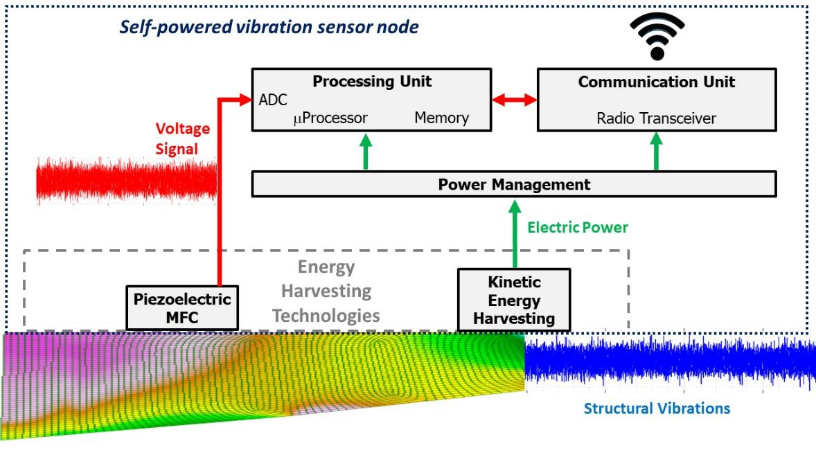
Hadas et al., Accepted for publication in Mechanical Systems and Signal Processing (Elsevier, IF 6,471):

Slide 56
WG3 Power management and energy harvesting
M3.1 Production of standardized testing documentation for energy harvesting in aerospace environments (M36)
Info/interface towards other WGs?
Industrial inputs?
Common work?
Early career investigators/training schools
Short-term missions?

Slide 57
Increasing cash-flow via:
Hybrid meetings/training schools (neighborhood countries physical, rest online) – e.g. workshop to tackle the EH standardization test(s)?
ITC grants for participation (fees) to virtual conferences
Preparation of educational/technical videos (MOOCs (incl. experiments)?, YouTube channel – V. Pakrashi already started it)
APC for OA publications
Dissemination activities (infographic, newsletter, hackathon, …?)

Slide 58
5. Working Groups Four
Name: Roman Śliwa
Organization: Rzeszów University of Technology, Poland
Email: rsliwa@prz.edu.pl
Management Committee Meeting (MC3)

Slide 59
Progress against Objectives
D4.1: Definition and publication of state of art so future developments in wireless technologies can be measured and assessed (Mo12)
  Report for WG4 in 2020
  Prepared in form of publication sent to SENSORS special Issue
Article
  Recent development in wireless communication in aviation, wind turbines and bridges
Prepared plan regarding activity of the WG4 for next periods of ODIN

Slide 60
Next Steps 2021
D4.2: Creation of an online repository, using already established approaches, of open source code that researchers can utilise and adapt (Mo24)
Aviation
  Direction 1: In the context of wireless communication in sensor networks, including IoT / IoE, we can distinguish three basic problems: efficiency, energy efficiency and security. In addition, existing research presents a limitation in the use of public key mechanisms such as digital signature algorithms. Therefore, further work may include the study of new reliable, efficient and energy-saving integrity schemes for data collection in the WSN network to significantly alleviate and reduce these problems through the use of safe and lightweight signature algorithms.
  Direction 2: Internet of Things (IoT) security and privacy with minimal performance requirements is an open research challenge. Blockchain technology, as a distributed and decentralized technology, could be a potential solution to deal with the limitations of current peer-to-peer IoT networks. This can be achieved by developing an integrated IoT system implementing an allowed blockchain to secure edge devices by applying a local authentication process and identifying data generated by IoT devices. The challenge is the scalability of IoT systems, computing power and problems with data storage by IoT edge devices in the blockchain network

Slide 61
Next Steps 2021
D4.2: Creation of an online repository, using already established approaches, of open source code that researchers can utilise and adapt (Mo24)
Aviation
  Direction 3: Wireless sensor networks require a high degree of synchronization to produce a data stream, and time discrepancy manifests itself as unwanted incidents, data distortions. Network Time Protocol (NTP) can provide accurate results, although it has a large variance depending on the environment and channel load. Therefore, an important task developed in further work will be the study of precise techniques for software clock synchronization in a network of connected devices in order to ensure stable microsecond accuracy regardless of the number of sensors and network operating conditions
  Direction 4: Realization of various tests based on RFID patnet on Czajka MP02A aircraft board – navigation on airport apron – runway. The use of wireless communication in the control of executive systems in case of damage.

Slide 62
Next Steps 2021
D4.2: Creation of an online repository, using already established approaches, of open source code that researchers can utilise and adapt (Mo24)
Bridges
  Optimizing of the sensor networks, selection of data transmission frequency and accepting the reduction of stability and reliability of signal transmission. Since comparing aerospace and wind turbines systems with bridges and civil engineering structures, the characteristics of detected and monitored events are less sudden and dynamic, thus optimizing of the sensor networks, data transmission frequency
Wind Turbines
  Since the beginning of 2021 the power plant wireless monitoring control systems are operational. This concerns the wind parameters and turbine energy production. There is also two directional wireless communication with the power plant, allowing the control of 12 rotor segments, each equipped with its own generator. Controls of the generators will allow to stop/start of each part of the wind turbine and also to prescribe operational parameters. One of important options will be setting up of limits as upper limit of rotational speed for reach generator independently.

Slide 63
Next Steps
Planned next zoom meetings of members of the group
We plan to attend online large conferences to present WG4 works
Presenting the ODIN COST ACTION during CAT AERONET Aviation Valley conference ( end of June 2021 or beginning of December 2021 ) – Special session for ODIN is considered

Slide 64
5. Working Groups Five
Name: Markus Sause
Organization: Universität Augsburg, Germany
Email: markus.sause@mrm.uni-augsburg.de
Management Committee Meeting (MC3)

Slide 65
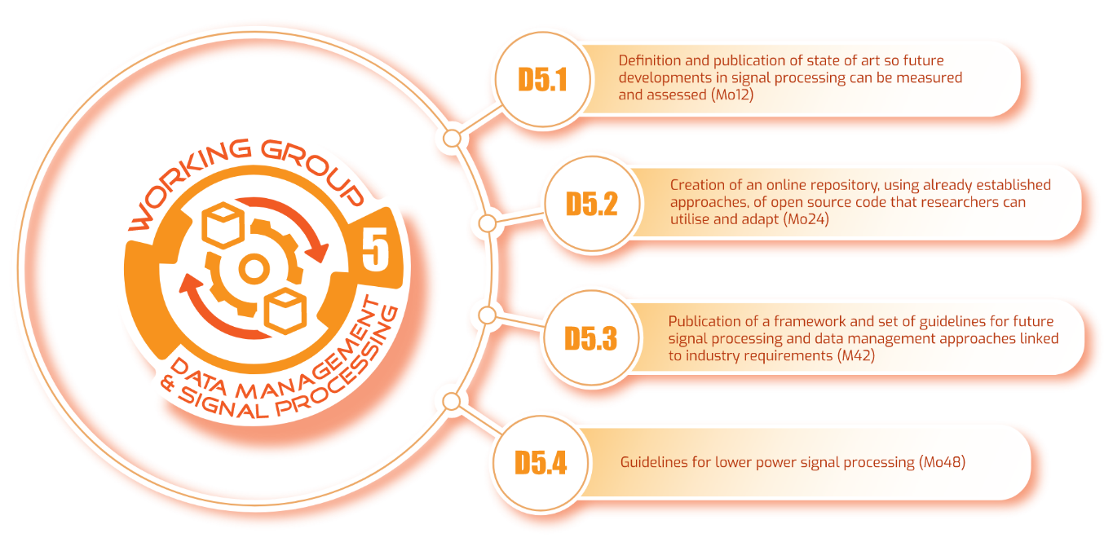

WG5 Signal Processing
Management Committee Meeting (MC3)

Slide 66
Publishing in Process
Introduction
Monitoring tasks in aerospace
Defect types
Aerospace requirements
Ultrasonics
Vibration based monitoring
Acoustic emission
Strain monitoring
Data reduction
Conclusions
Management Committee Meeting (MC3)

Slide 67
What’s next?
Active recruiting of WG members from signal processing
Evaluating possibilities for an online repository
Establishing tighter links to WG3 in preparation to D5.4
Management Committee Meeting (MC3)

Slide 68
10. Scientific Planning
Management Committee Meeting (MC3)

Slide 69
a) Scientific strategy
Immediate MoU Objectives
  Objective 1 - Development of a common understanding and definition of the subject matter (End Year 1) - completed
  Objective 2 - Coordination of experimentation and performance assessment of technology (End Year 1) - ongoing
  Objective 3 - Coordination of information seeking, identification, collection and/or data curation (End Year 3)
What should the grant period objectives be to achieve MoU objectives?
  Training School?
  Webinar?

Slide 70
b) Long Term Planning
Online Training School in Energy Harvesting/AE and Signal Processing?
  Four day event that can support objectives
Proposed Activities
  Training School in Signal Processing (Dublin)
  Management Committee Meeting 4 in Poland?
  Five ITC conference grants – focus on particular conferences sessions we organise?

Slide 71
d) Dissemination planning (Publications and outreach)
Website and LinkedIn page established
  Need more content
  Videos/images/data
Publications of “State of the Art” completed
  Open access costs?
Agreement to create a Special Issue of “Sensors” (ISSN 1424-8220 IF 3.031)
  Ongoing, two ODIN papers, published in May 2021

Slide 72
d) Dissemination planning (Publications and outreach)
Organising Special Sessions at targeted conferences (EASN 2021/Wireless conefernce)
Attracted funding for manufacture of demonstrator as part of Airbus Project
  Cardiff will manufacture two demonstrators (identify funding for composites for specimen 2)
  Test first in Spring/Summer 2021

Slide 73
11. Any Other Business
Management Committee Meeting (MC3)

Slide 74
12. Location and Date of Next Meeting
TBC – COVID Dependent
Management Committee Meeting (MC3)

Slide 75
13. Summary of Decisions
Management Committee Meeting (MC3)

Slide 76
Decisions (added post meeting)
Website Corrections from KM (RP/PD)
All COST members to sign up to LinkedIn and You Tube Channels
  https://www.linkedin.com/groups/13834579/
  https://www.youtube.com/channel/UCHsuZiTHN15C857yiL_D6kg
Completion of Progress Report 2 (online PDF) (RP)
Organise ITC conference grants for online special sessions (Core Group (CG))
  Please submit conferences to Action Chair (All)
KM to send Action Slides to RP
RP/EJ to send joint conference information to KM (RP/EJ)
RP to send all slides from MC meetings to PD for website (PD)

Slide 77
14. Meeting Close
Management Committee Meeting (MC3)

